Slide 1
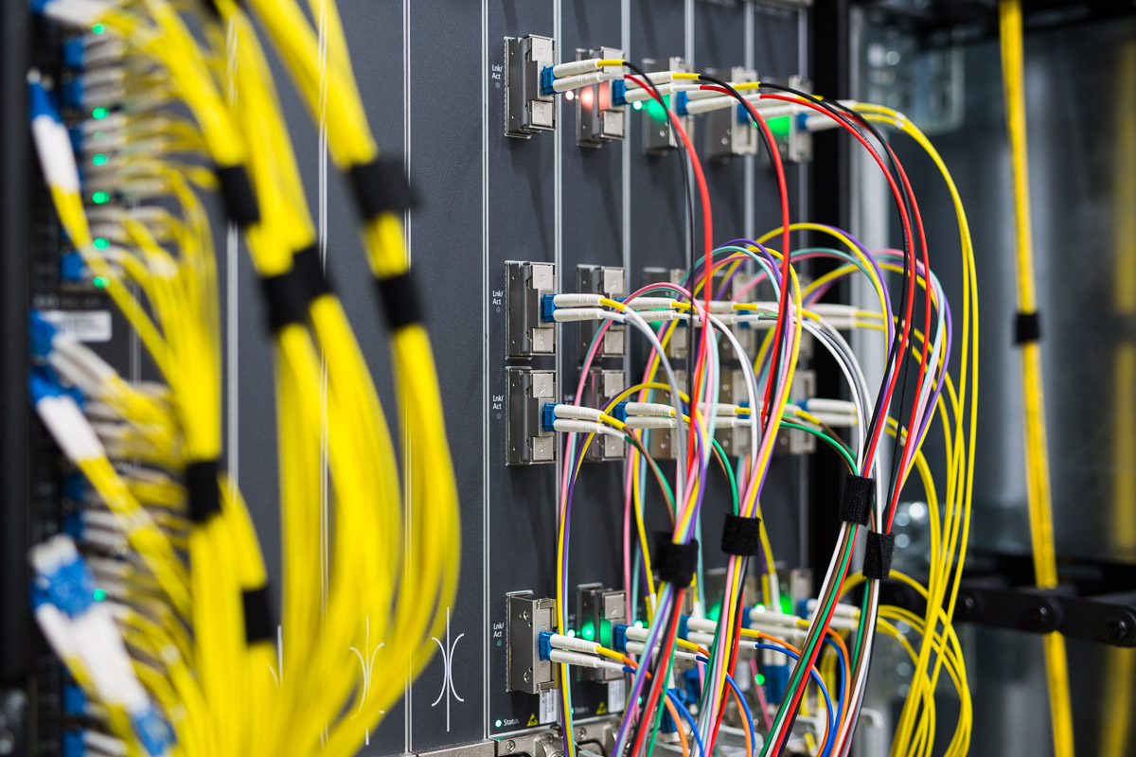
Middle East
Looking at 10 Years of Peering: where are we today?
MENOG22 – Bernd Spiess

Slide 2
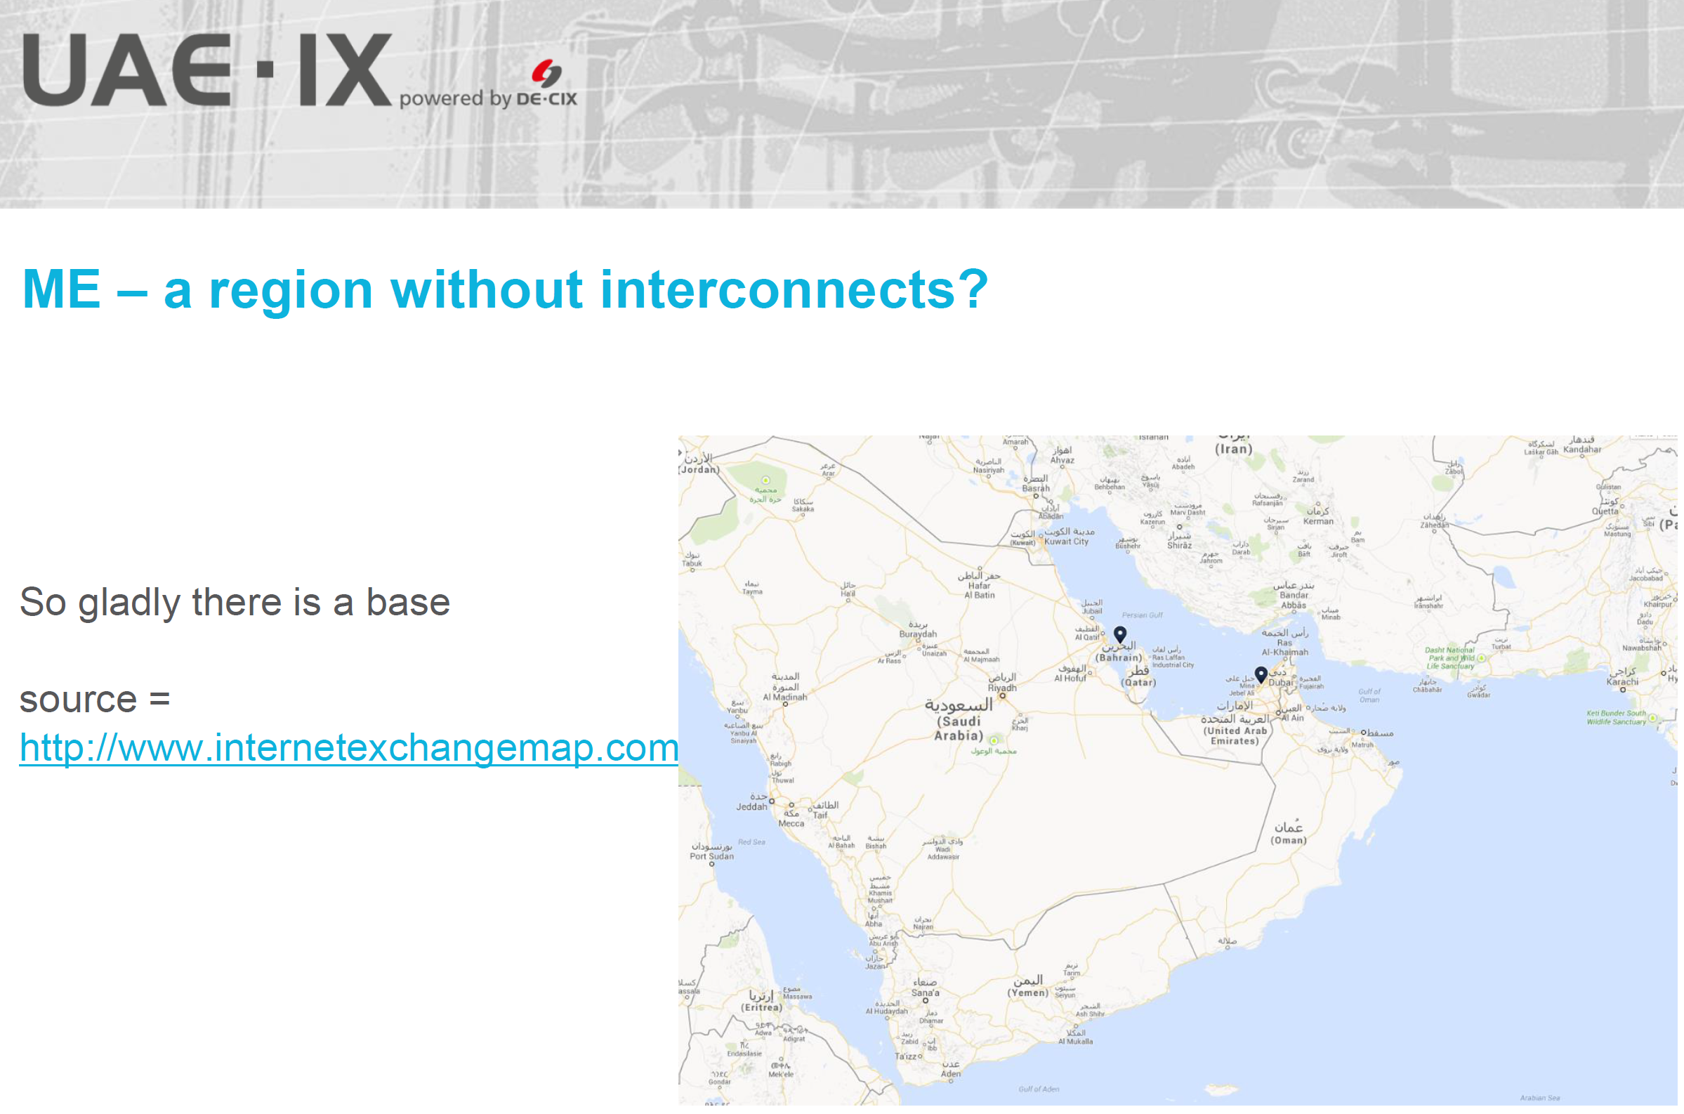
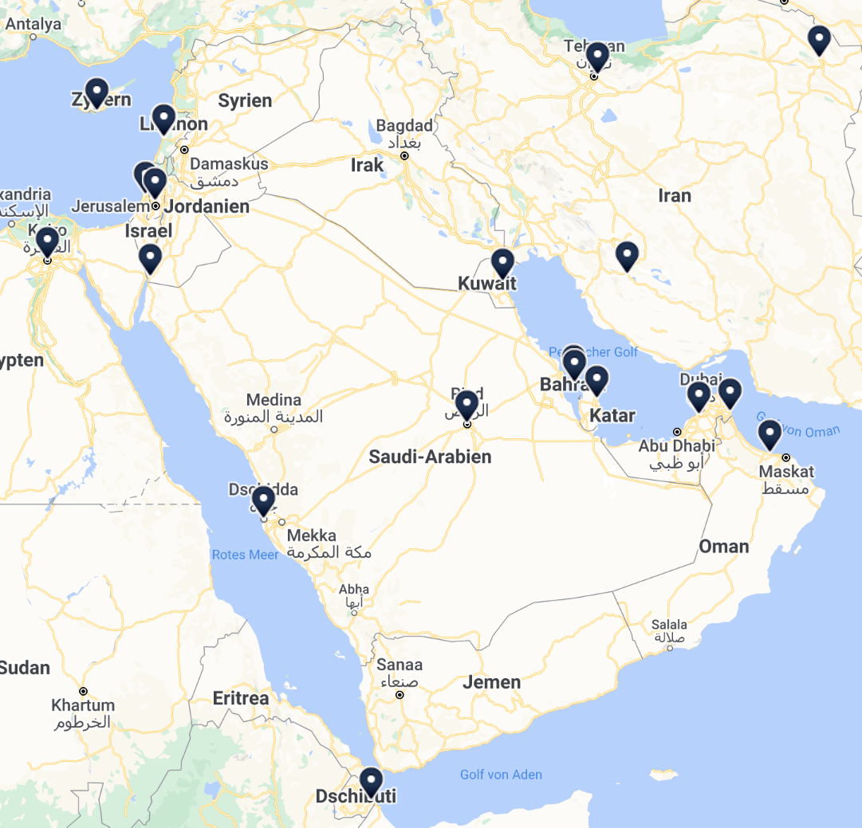
Peering Landscape …
2013 vs. 2022

Slide 3
Which IXP are seen in 2022? (source: peeringdb.com, ixp > 1 peer, 16.11.)
Country | IXP | Peers | Con. Bandwidth | Peak (6.12.22)
Bahrain | MANAMA-IX⁽¹⁾ | 23 | 1.000 Gbps | 540 Gbps
Djibouti | DJIX | 12 | 75 Gbps | 20 Gbps
Egypt | CAIX | 4 | 4 Gbps | ?
Egypt | EG-IX⁽¹⁾ | 3 | 202 Gbps | ?
Egypt | PyramIX | 30 | 34 Gbps | ?
Iran (=> Homepage) | Tehran IXP | 2 => 20 | 50 => 8.400 Gbps | 3.590 6.621 Gbps
Jordan | AqabaIX⁽³⁾ | 13 | 122 Gbps | ?
KSA | JEDIX⁽²⁾ | 19 | 1.400 Gbps | 316 Gbps
KSA | SAIX | 17 | 990 Gbps | 146 Gbps
Kuwait | ix.kw | 16 | 274 Gbps | ~40 Gbps
Oman | Equinix Muscat | 6 | 270 Gbps | ?
Qatar | QIX | 5 | 41 Gbps | ?
UAE | SH-IX | 29 | 258 Gbps | ?
UAE | UAE-IX⁽³⁾ | 82 | 2.300 Gbps | 392 Gbps
(1) powered by AMS-IX
(2) powered by LINX
(3) powered by DE-CIX

Slide 4
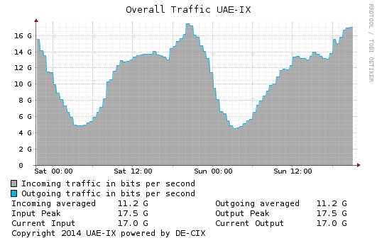
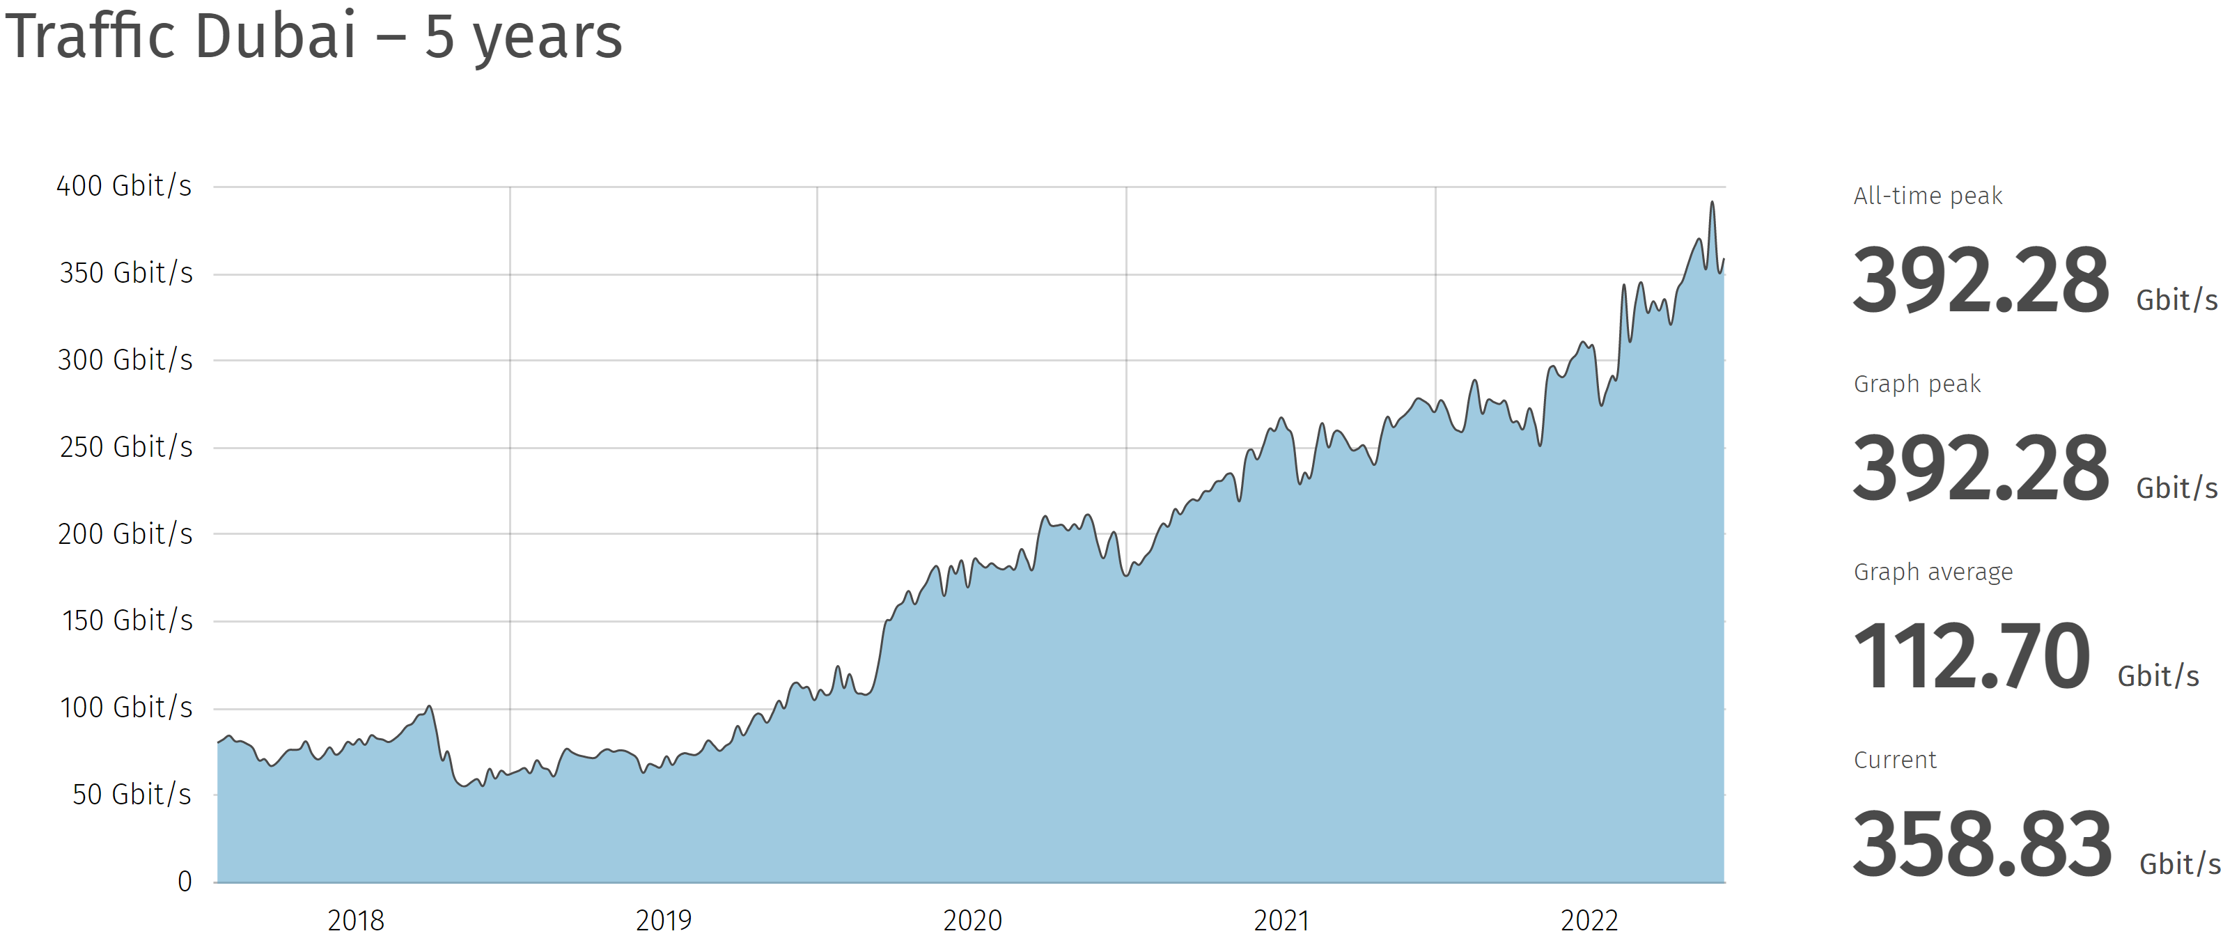
Growth Example of an IXP
2014
2022

Slide 5
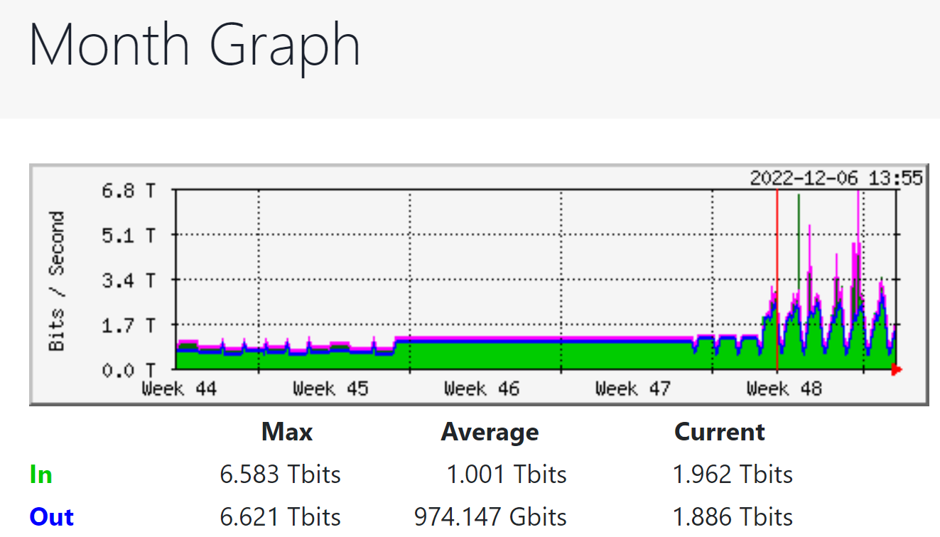
Tehran IX: the last week
https://members.tehran-ix.ir/statistics/ixp

Slide 6
Where are the n x 100 Gbps
Connects?
(peeringdb.com)
Note:
Content vs. Eyeball Networks
n x 10 must not be ignored!
No, there is no 400 Gbps found

Slide 7
Where are the big active
Cloud Zones
(Homepagecheck)
Note:
Sorry for ignoring other players
(Google Cloud not found active)

Slide 8
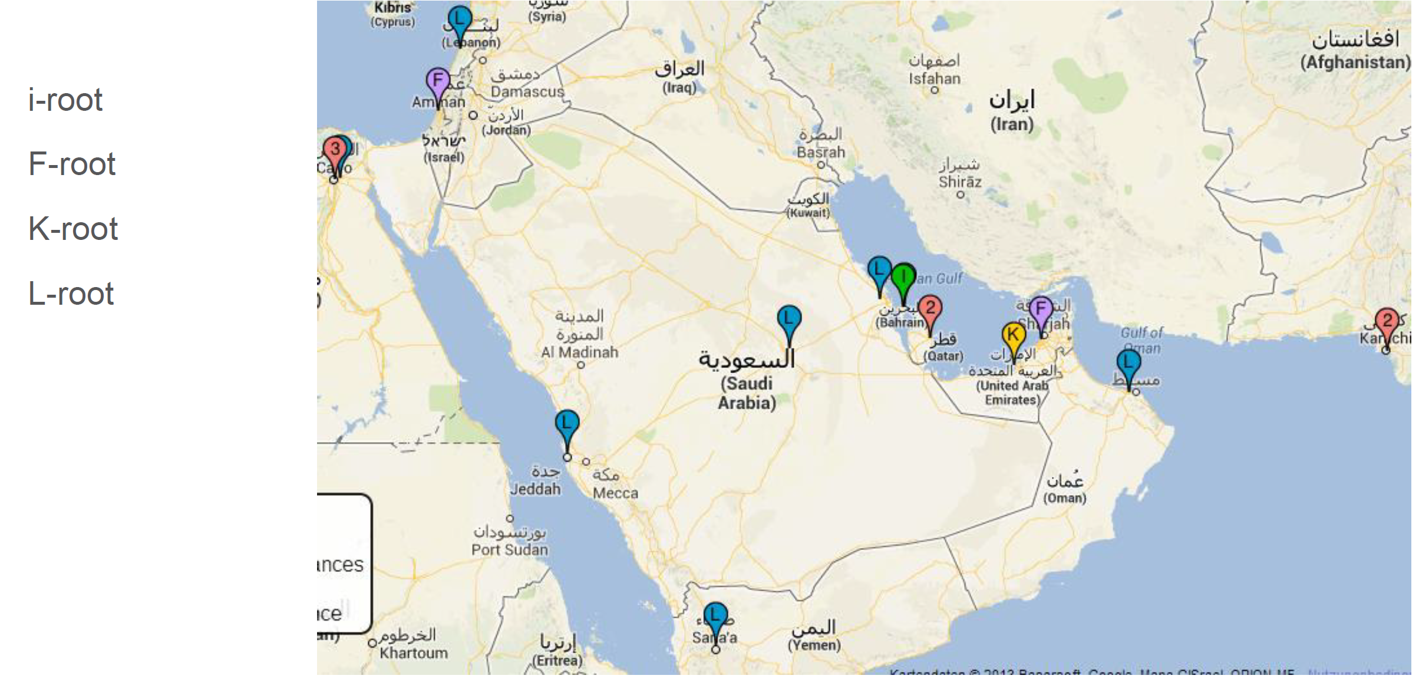
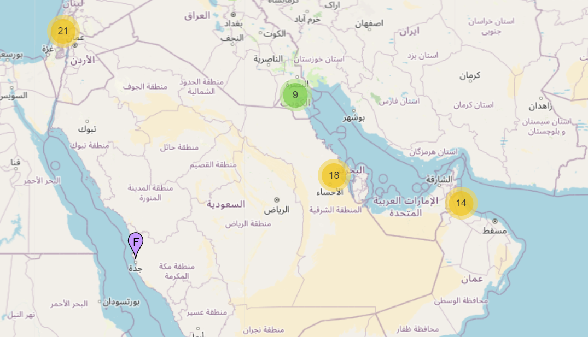
root-servers in the Region
D-root
E-root
F-root
H-root
i-root
J-root
K-root
L-root
2022
2014

Slide 9
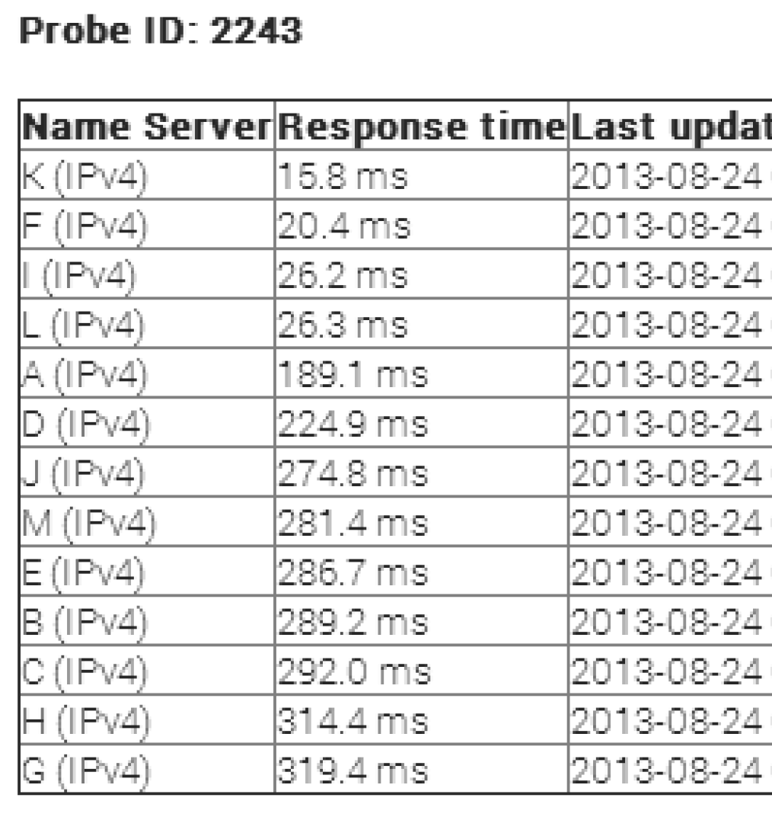
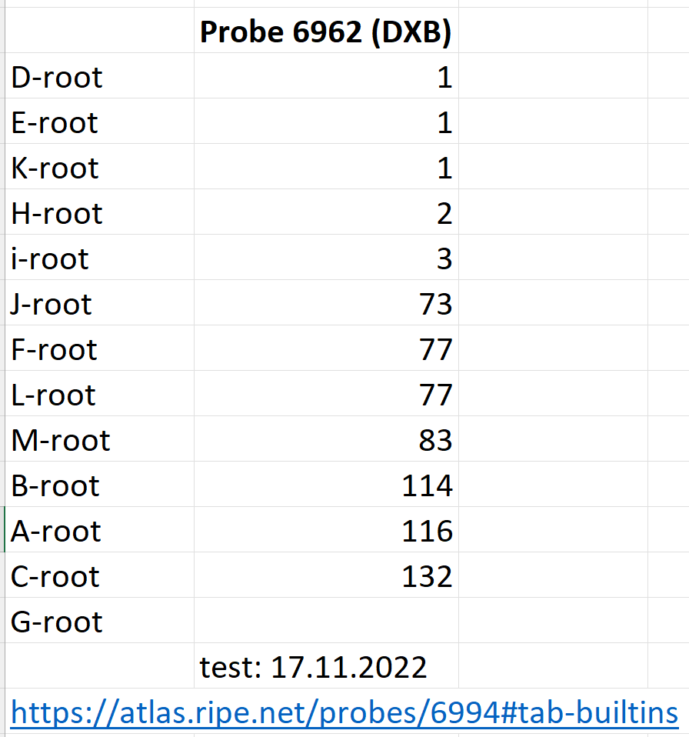
Latency Changes to root-servers
2013
2022

Slide 10
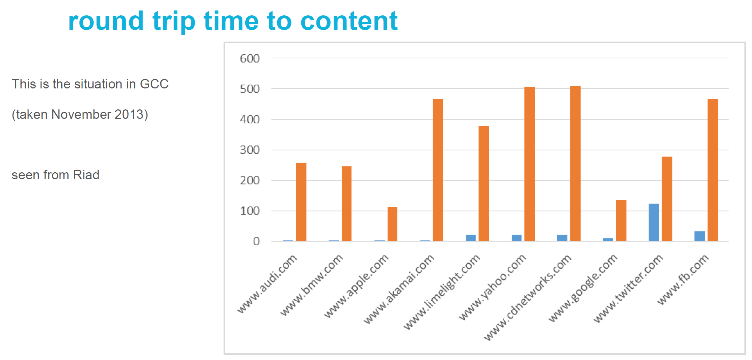
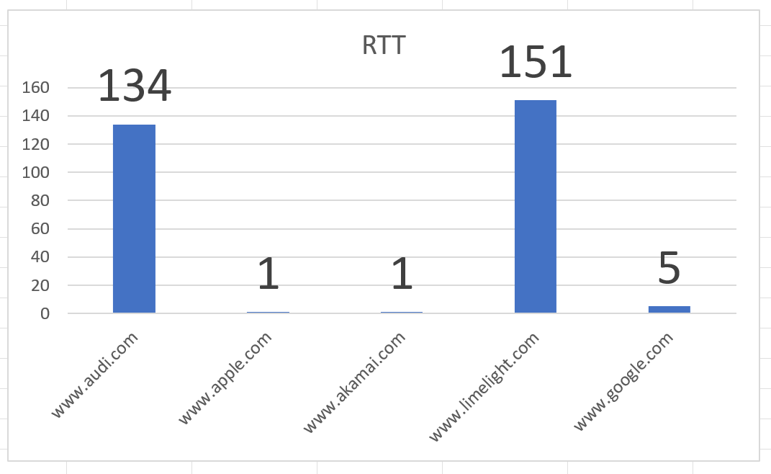
Latency Changes to Content
2022 (DXB)
2013

Slide 11
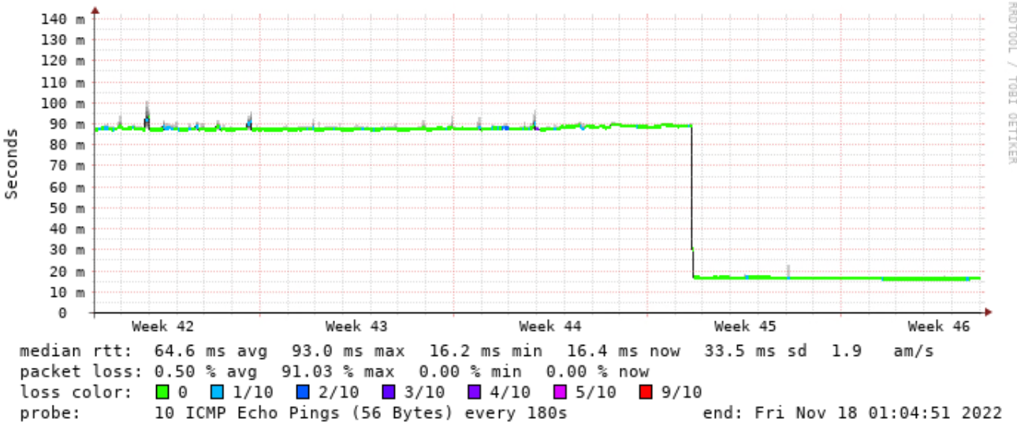
Some Regional Peering Highlights
(the Power of Peering)
RTT from Dubai/UAE-IX to Pakistan via a remote SH-IX peering

Slide 12
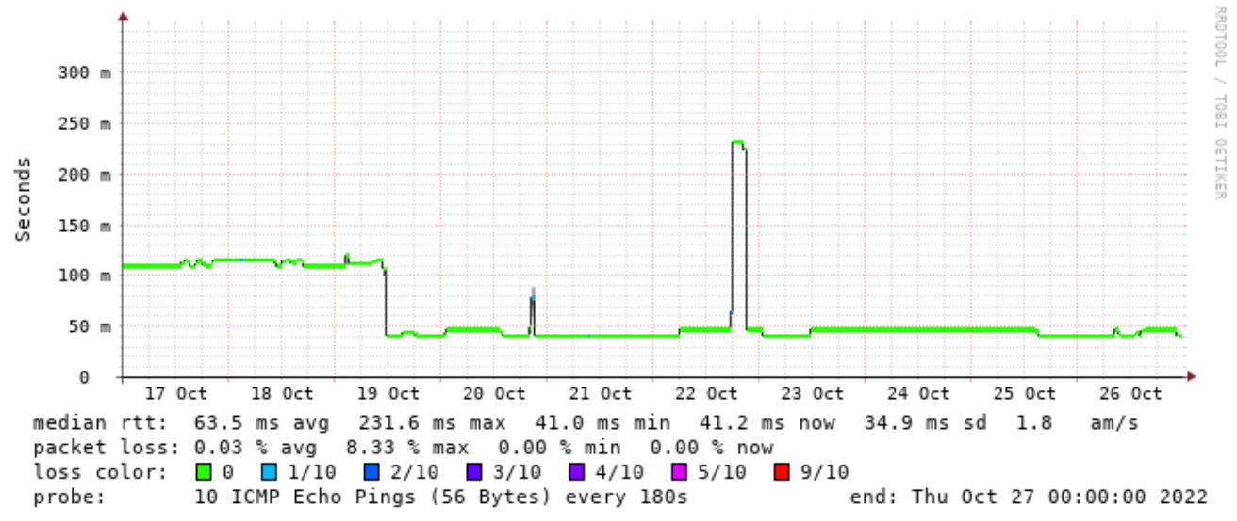
Some Regional Peering Highlights
(the Power of Peering)
RTT from Dubai/UAE-IX to Afghanistan via a remote SH-IX peering

Slide 13
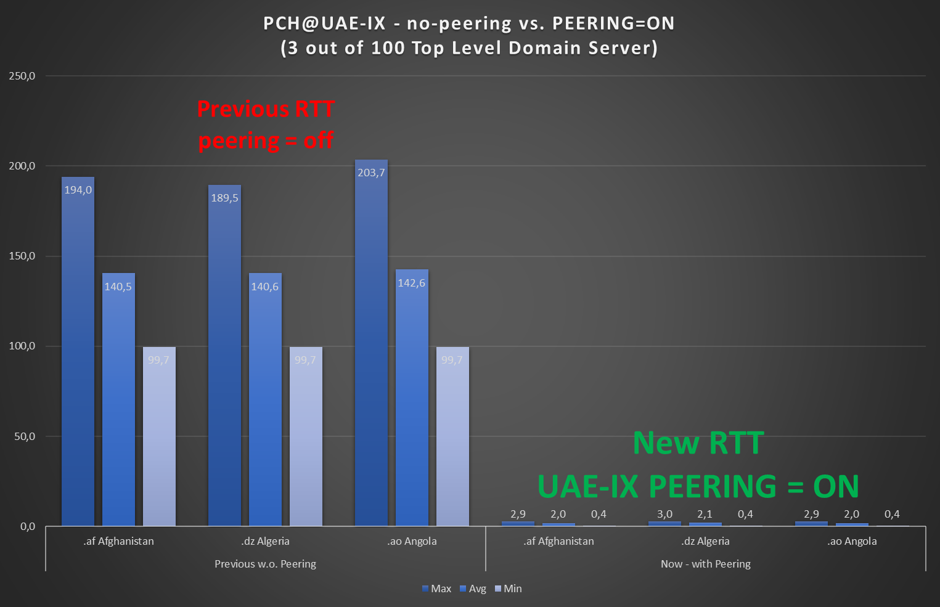
Why placing TLD Anycast into the region
PCH peering re-turn-up improved
~ 100 CC TLD
from
> 100 msec to
~ 1 msec RTT

Slide 14
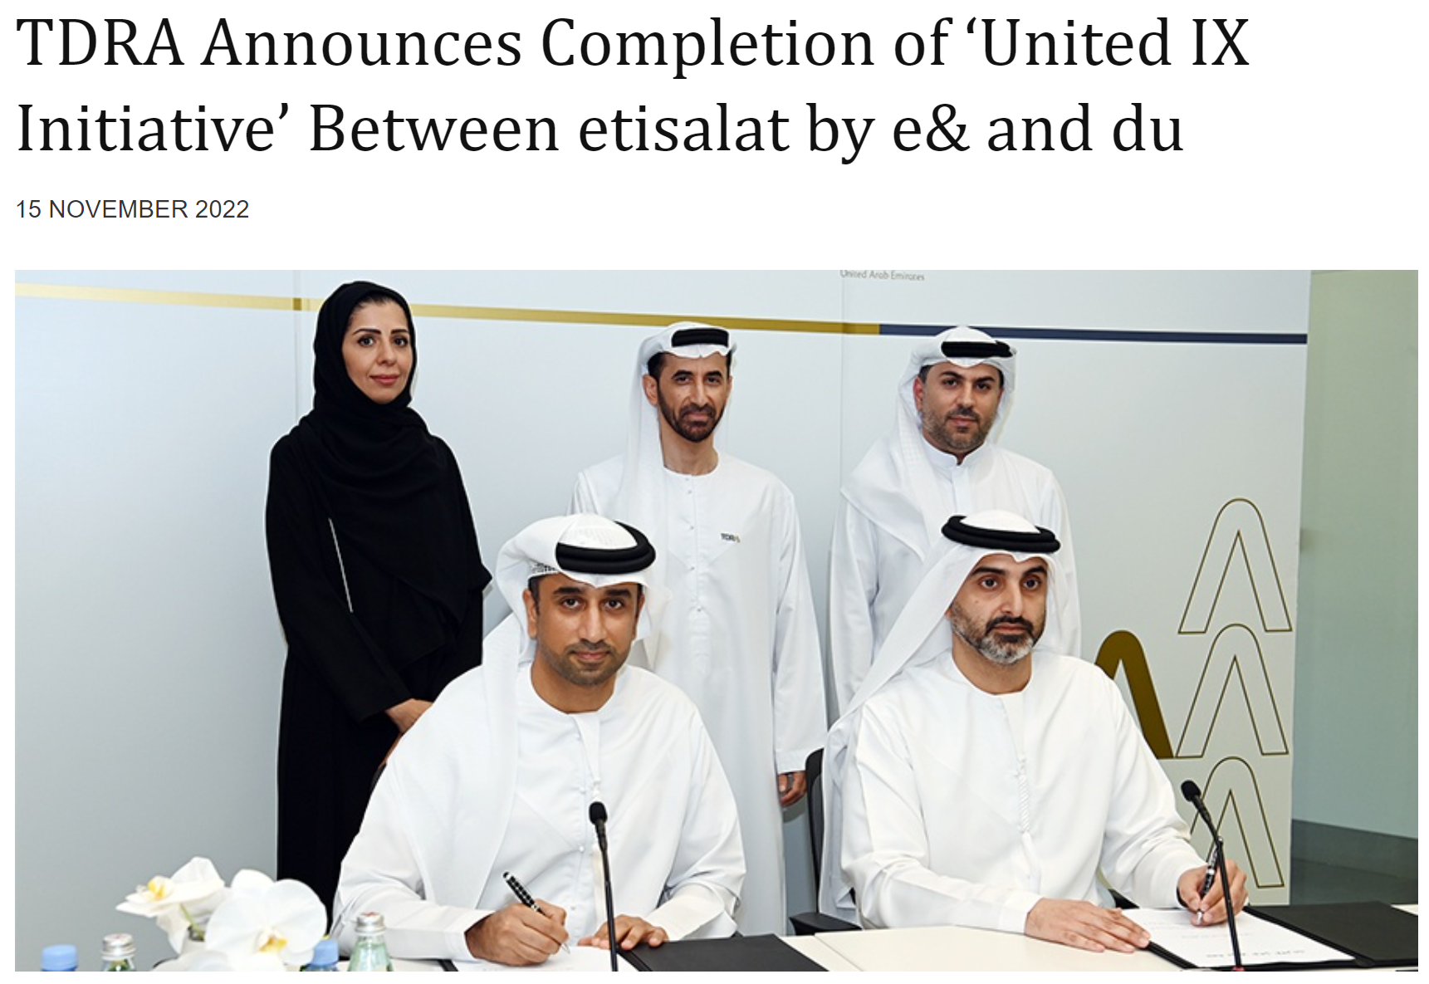
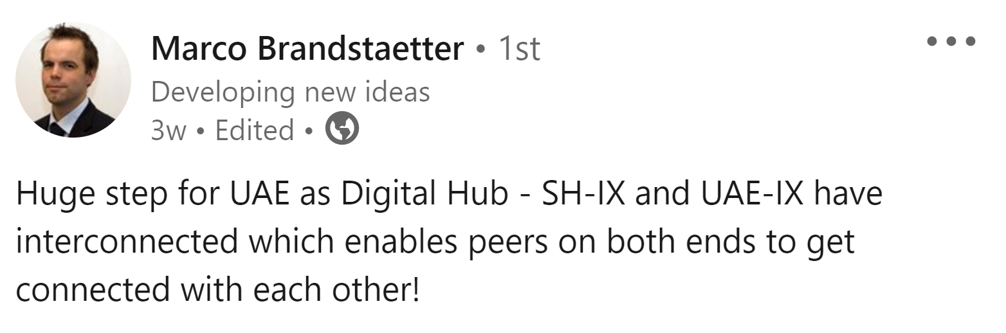
IXP Developments Highlight:

Slide 15
Examples of ongoing challenges:
Wrong or missing IRR entries causing filter issues
  Tip: Talk tomorrow: Hanna/MANRS
RPKI invalid or no RPKI
  Tip: Recording(?) of Talks: Nina/Kentik, Jad/RIPE
  Tip: ROA Signing Party today at 16:00
More specific routes on transit but not at peering
Big capacities to Europe/Singapore instead in the region
Lots of missing peering
Interconnection between IXPs and markets
Regional Content not in the Region
Missing RIPE Atlas Probes

Slide 16
Thank You!
bernd.spiess@de-cix.net

